Slide 1

Automated Number Plate Detection Entry System
Welcome! This presentation explores the development of an automated number plate detection entry system, leveraging advanced machine learning techniques.

Slide 2
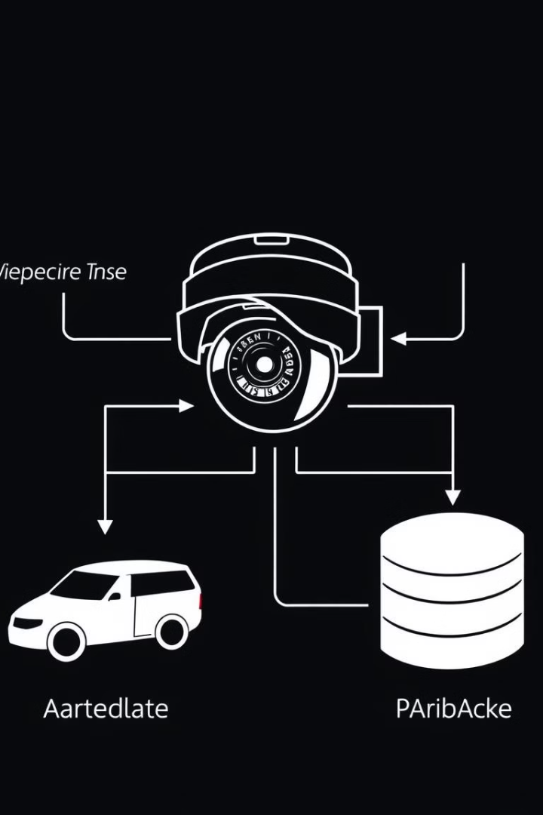
Components of the Entry System
1
Camera
2
Number Plate Recognition Engine
High-resolution cameras capture images of vehicles entering the system.
This engine uses machine learning to detect and recognize number plates from captured images.
3
Access Control System
4
Database
Data about vehicles, authorized users, and access logs are stored for analysis and security purposes.
The system grants or denies entry based on recognized number plates and configured access rules.

Slide 3
Plate Detection and Recognition
Image Preprocessing
Plate Localization
Character Recognition
Images are cleaned and enhanced to improve the accuracy of detection.
The system identifies the region in the image containing the number plate.
Individual characters on the number plate are extracted and recognized using machine learning algorithms.

Slide 4
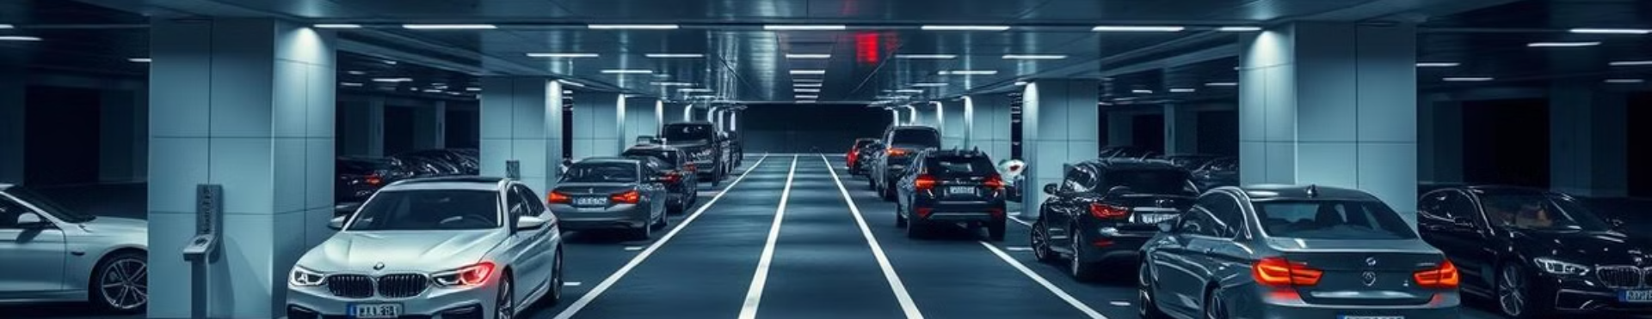



Vehicle Tracking and Monitoring
Entry Detection
Vehicle Tracking
Exit Detection
The system detects when a vehicle enters the monitored area.
The system follows the vehicle's movement within the monitored area.
The system identifies when a vehicle leaves the monitored area.

Slide 5
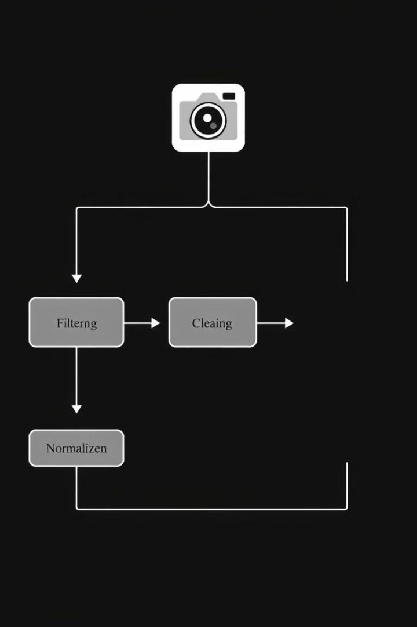
Data Collection and Preprocessing
1
Data Acquisition
Images of vehicles are captured by cameras at designated entry points.
2
Data Cleaning
Images are processed to remove noise, blur, and other artifacts.
3
Data Normalization
Images are resized and standardized for consistent input to the recognition engine.

Slide 6
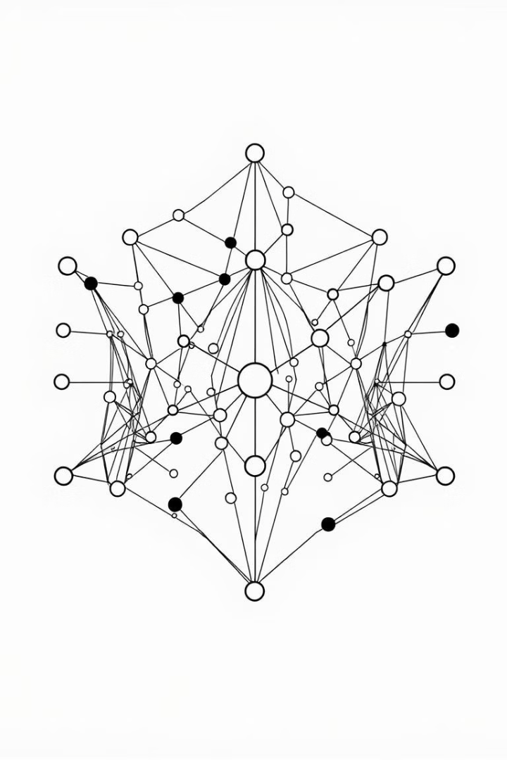
Modeling and Algorithm Implementation
Algorithm
Description
Convolutional Neural Networks (CNNs)
Feature extraction for recognizing patterns in number plates.
Support Vector Machines (SVMs)
Classification of number plates based on extracted features.
Recurrent Neural Networks (RNNs)
Handling sequence data, such as character sequences in number plates.

Slide 7

Benefits and Future Considerations
Enhanced Security
Increased Efficiency
Improved access control for secure premises, reducing unauthorized entries.
Streamlined entry processes, minimizing wait times and improving traffic flow.
Data-Driven Insights
Collected data provides valuable insights into traffic patterns and user behavior.

Slide 8




Team Members
ARYAN GHOSLE
Backend Development and Model Training
ANURAG SONI
Frontend Development, Deployment

